Slide 1
Final Team Project Milestone 1 Selected Machine Learning Algorithm: Convolution Neural networks Super Classes: Vehicle 1 and Vehicle 2
Group 8: Aarathi Nadathur, Amar Ippili, Divya Puraswani, Sai Chaitanaya Tolem, Sameer Rajput, Shubh Johri
CMPE257-Spring 2019

Slide 2
Dataset-CIFAR-100
The 100 classes in the CIFAR-100 are grouped into 20 super classes with 600 images in each class.
There are 500 training images and 100 testing images per class.
Each image comes with a "fine" label (the class to which it belongs) and a "coarse" label (the superclass to which it belongs).
Our goal is to perform a binary classification of images in vehicle 1 and vehicle 2 superclass pairs.
Superclass –vehicle 1
Class- bicycle, bus, motorcycle, pickup truck, train
vehicle 2
Class- rocket, tank, tractor, streetcar, lawn-mower

Slide 3


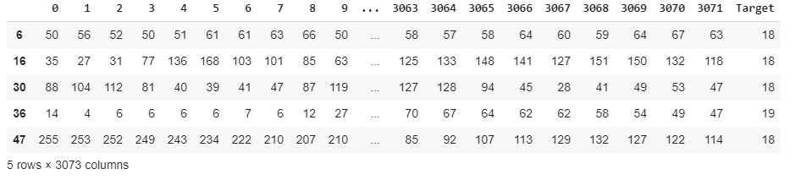
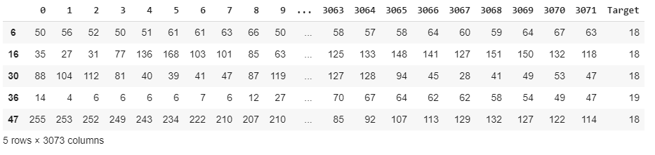
Cifar100
Images (60000 X 3072)
Coarse Labels (0-19)
1
Load
+
2
Convert
X
Y
DataFrame
Train
Test
Meta
18 = Vehicle 1
19 = Vehicle 2
Filtered Dataset(Target = 18 / 19)
Filter
3

Slide 4
Search in list
Index of Vehicle 1 : 18
Index of Vehicle 2 : 19
Dictionary
{ }
[0-19]
[ Fish , Flowers……………….]
Coarse Labels :
[ apple , baby, bear.……….]
Fine Labels :
[0-99]
Meta

Slide 5
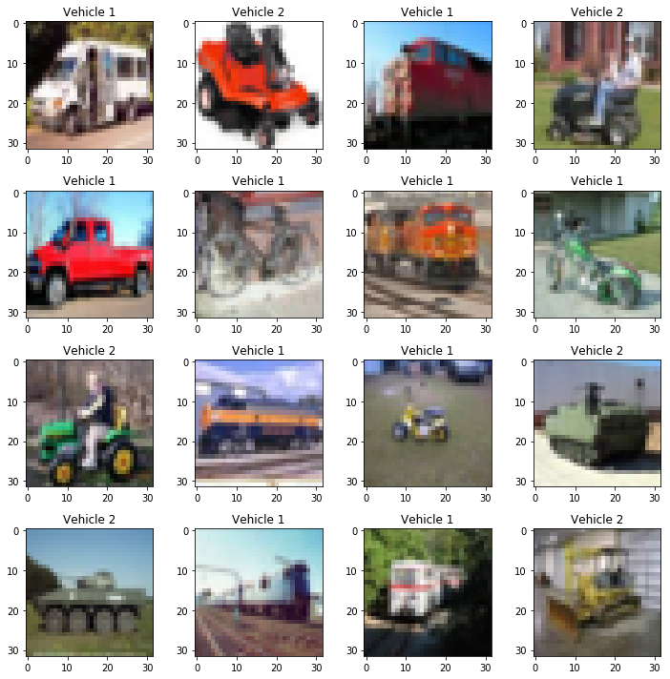
Validation of classes

Slide 6
Machine Learning Algorithms
Algorithms worked on:
Algorithm | Accuracy Achieved
Logistic Regression | 60.08%
Random Forest | 69.83%
Decision Tree Classifier | 58.16%
SVM | 68.88%
K-Nearest Neighbors | 61.66%
Naive Bayes | 55.83%
CNN | 83.33%

Slide 7
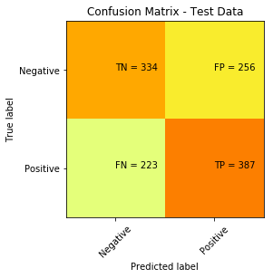
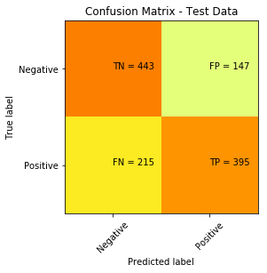
Machine Learning Algorithms
Confusion Matrix
Logistic Regression
Random Forest

Slide 8
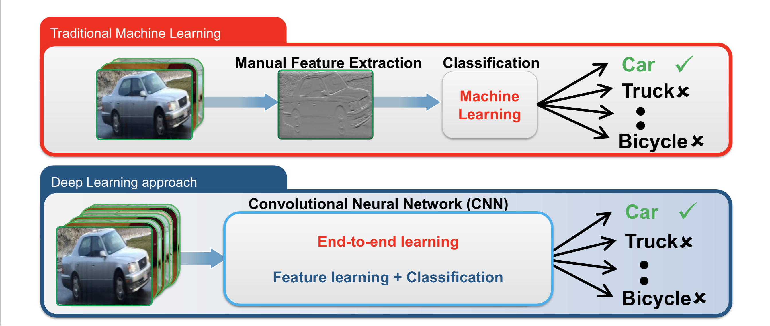
Why Convolutional Neural Network?

Slide 9
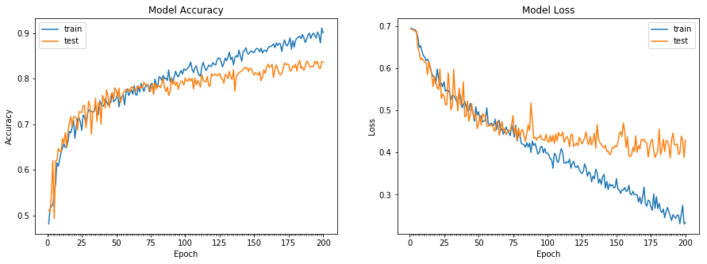
Machine Learning Algorithms
CNN model
Accuracy Achieved=83.67%

Slide 10
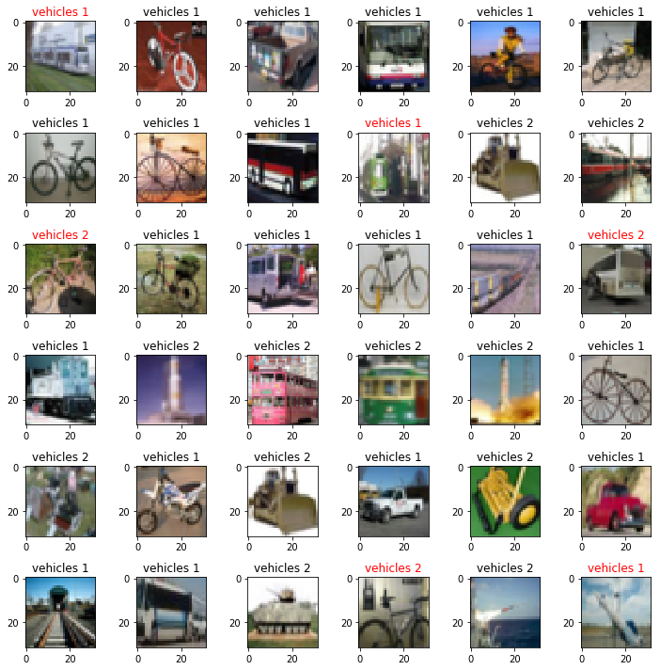
Output

Slide 11
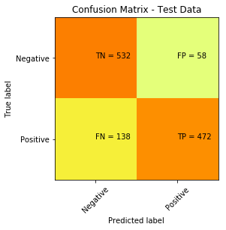
Confusion Matrix

Slide 12
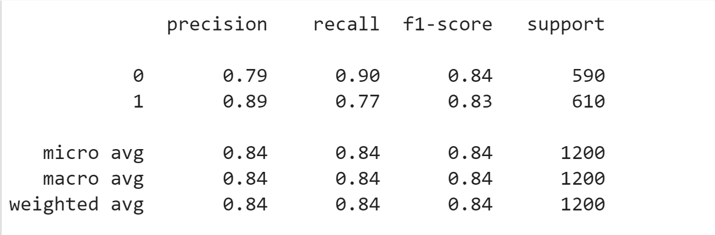
Classification Report

Slide 13
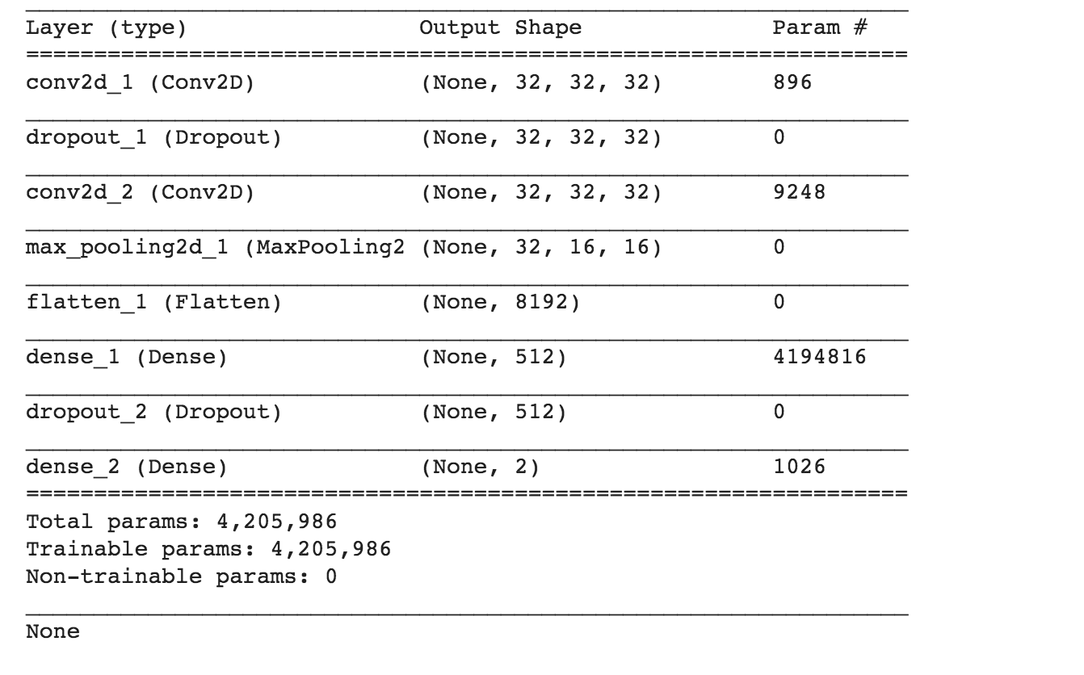
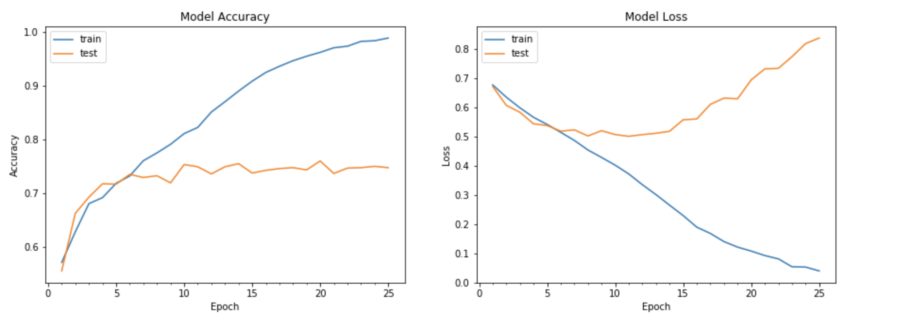
Improvement-Model 1
Batch size=32
Number of epochs=25
Loss=binary_crossentropy
Optimizer=sgd
Learning rate=0.01
Data Augmentation=No
Accuracy Achieved=74.75%

Slide 14
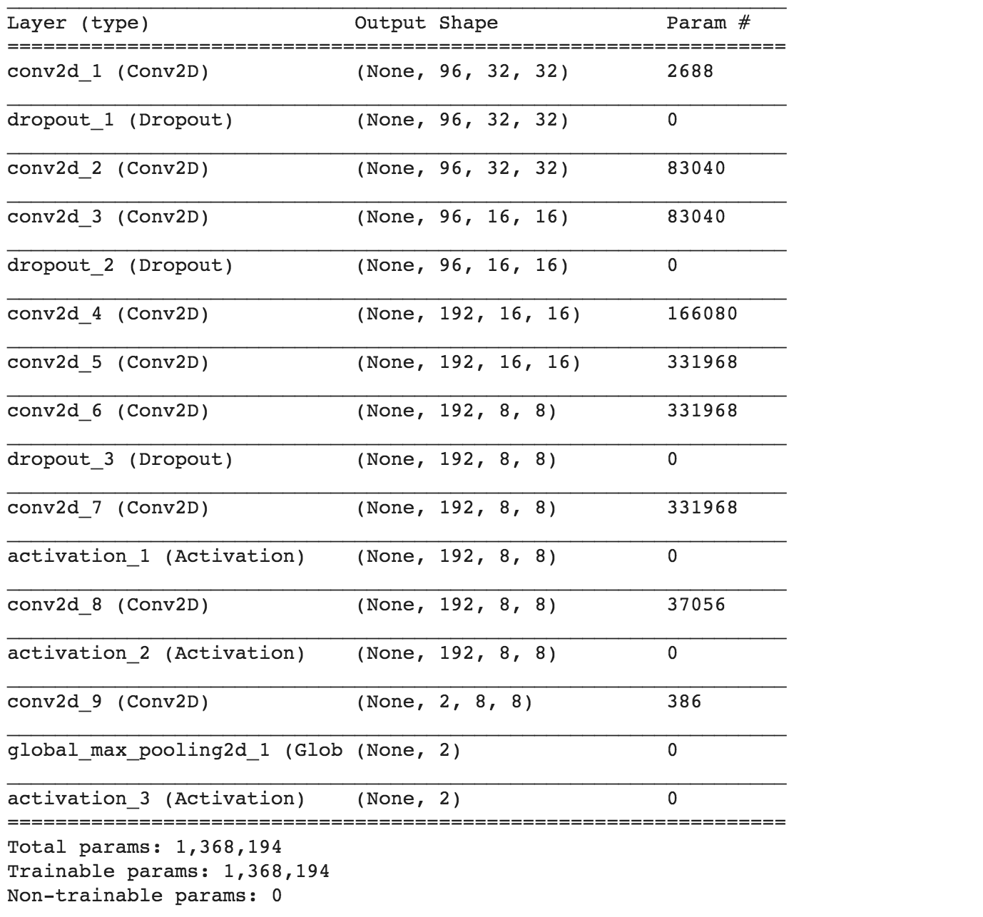
Improvement-Model 2
Batch size=256
Number of epochs=175
Loss=binary_crossentropy
Optimizer=Adam
Learning rate=0.0001
Data Augmentation=Yes
Accuracy Achieved=78.84% with Pure CNN

Slide 15
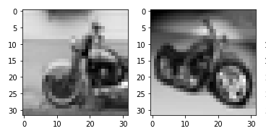
Additional experiments done
Converting RGB images to greyscale: accuracy was 73.58% with 50 epochs and computation was fast
Variable learning rates in CNN
Batch Normalization Layer

Slide 16
Lessons Learned
Computation matters!
SVM took maximum time for training.
Rerunning the Sequence model will append all the newly generated convolution/dense layers to the previous model – Should Reset runtime in Colaboratory
CNN is better than all other algorithms for Image Classification

